Slide 1
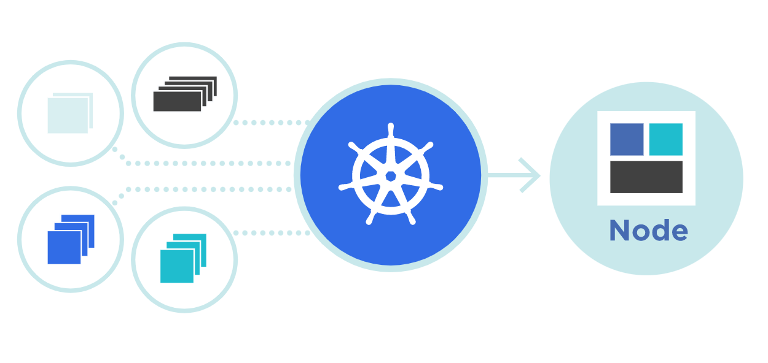



YAML
Theory + LAB + Documents ➔ All free
WATCH NOW

Slide 2
Contact Details: - Anish Rana - Contact Hours: 9am-3pm, Sat & Sun - Linkedin: www.linkedin.com/in/anishrana2001 Github: https://github.com/anishrana2001/Kubernetes/tree/main/05%20Yaml%20file Youtube : anishrana2001

Slide 3
YAML
By Anish Rana

Slide 4
Course Outline
History and Name
Structure of a YAML file
What is a key-value pair?
YAML Array List
Dictionary / Maps
Rule for creating YAML file

Slide 5
History and name
YAML was first proposed by Clark Evans in 2001.
Who designed it together with Ingy döt Net and Oren Ben-Kiki.
Originally YAML was said to mean Yet Another Markup Language, because it was released in an era that saw an increasing of markup languages for presentation and connectivity (HTML, XML, SGML, etc).
But it was then repurposed as a recursive acronym, to distinguish its purpose as data-oriented, rather than document markup.
Before = Yet Another Markup Language
Now = YAML Ain’t Markup Language

Slide 6
According to yaml.org, "YAML is a human-friendly, data serialization standard for all programming languages."
YAML common use cases such as:
Configuration files
Log files
Inter-process messaging
Cross-language data sharing
Complex data structures

Slide 7
Structure of a YAML file
There are 3 building blocks of a YAML file:
Key value pair
Arrary / Lists
Dictionary / Map

Slide 8
What is a key-value pair?
A key-value pair is a simple data structure that consists of a unique identifier (the key) and the corresponding value of that identifier.
The key can be any type of data, such as a text string or an integer.
The data can also be of any type of data, including string, integer, float, boolean, list, or even other key-value pairs.

Slide 9
Syntax
key: value
Yaml format
name: anish rana
age: 24
occupation: system admin
fruit: apple
salary: $1000.5
Each key is followed by a colon and then the value.
name | age | occupation | fruit | salary
anish rana | 24 | system admin | apple | $10000.5

Slide 10
YAML Array List
An array is a group of similar values with a single name.
In YAML, Array represents a single key mapped to multiple values. Each value starts with a hyphen - symbol followed by space.
Syntax:
key1:
- value1
- value2
- value3
- value4
Or
key1: [value1,value2,value3,value4]
{
"key1": [
"value1",
"value2",
"value3",
"value4",
]
}
key1: [value1,value2,value3,value4]
In yaml
Notes:
Next is Dictionary or MAPs

Slide 11
Dictionary / Maps
Dictionary in normal
In Yaml
Banana:
fat: 0.5g
carbs: 32g
calories: 190
Grapes:
fat: 0.3g
carbs: 24g
calories: 120
Banana:
- fat: 0.5g
carbs: 32g
calories: 190
Grapes:
- fat: 0.3g
carbs: 24g
calories: 120

Slide 12
Rule for creating YAML file
The file should have ".yaml" as the extension.
The file starts with three dashes (---). These dashes indicate the start of a new YAML document.
Multiple documents with single streams are separated with 3 hyphens (---).
Comments must be separated from other tokens by whitespaces.
YAML is case sensitive.
Indentation of whitespace is used to denote structure.
Tabs are not included as indentation for YAML files.

Slide 13
Yaml File
apiVersion:
kind:
V1 or V2

Slide 14
Yaml File
apiVersion:
kind:
v1
POD

Slide 15
Yaml File
v2
apiVersion:
kind:
Deployment
Notes:
if we are Deployment then we use Kind is equal to Deployment. I will explain it on my next videos what is Deployment. Don’t worry.
Lets focus on YAML topic.
Thus, kind represents what we are creating .

Slide 16
Yaml File
apiVersion:
kind:
metadata:
spec:
V1 or V2

Slide 17
Yaml File
apiVersion:
kind:
metadata:
name: cust1-webapp
labels:
app: nginxdata
v1
POD

Slide 18
Yaml File
apiVersion: v1
kind: Pod
metadata:
name: cust1-webapp
labels:
app: nginxdata
spec:
containers:
- name: cust1-nginx
image: nginx
- name: cust1-database
image: postgres

Slide 19
Thank you
Notes:
If you have any questions, you may ask in the comment session, I will try to reply you.
If you like this video and content, Please like and subscribe to my channel and press the bell icon to get new video updates.”

